Slide 1
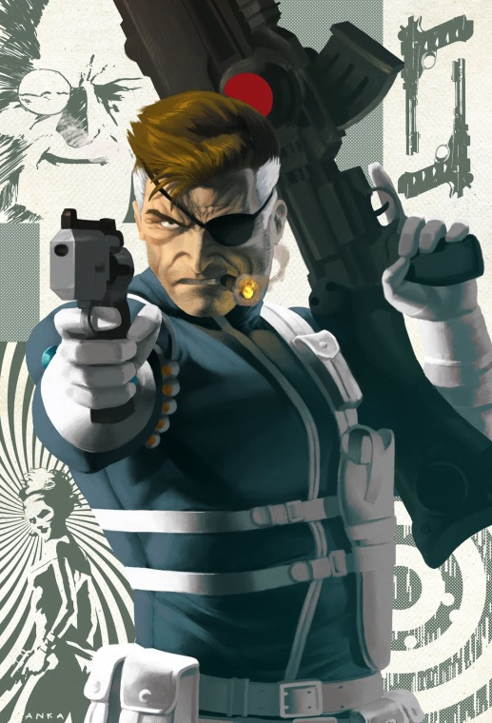
Team Nick Fury
Winter sports 2014 – C#2 project
Team members:
Yanko Tsigularov Tsigularov
Vasil Bonev V45370
Victor Draganov veke_D
Stefan Popgeorgiev StefanPopgeorgiev
Stavri Zoichkin S.Zoichkin
Nikolay Gornakov Gornakov
Telerik Software Academy
http://academy.telerik.com

Slide 2
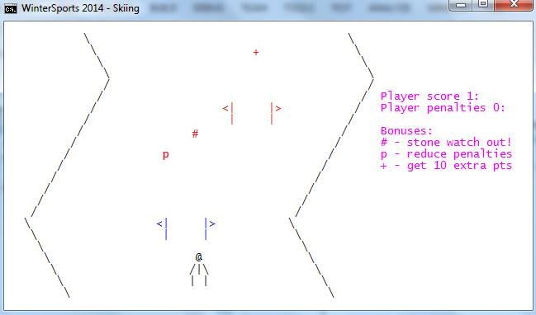

Gameplay
Main goals
Passing through the gates
Collecting bonuses
Game over
When player get 3 penalties
When player hit a stone

Slide 3


Game design and Implementation
* Used .NET Classes:
System.Console, System.Random, SystemCollectionGenericList<T>, System.Threading.Thread
* Used 2 user classes
4 structs
29 methods implementing game logic
2 external text files

Slide 4
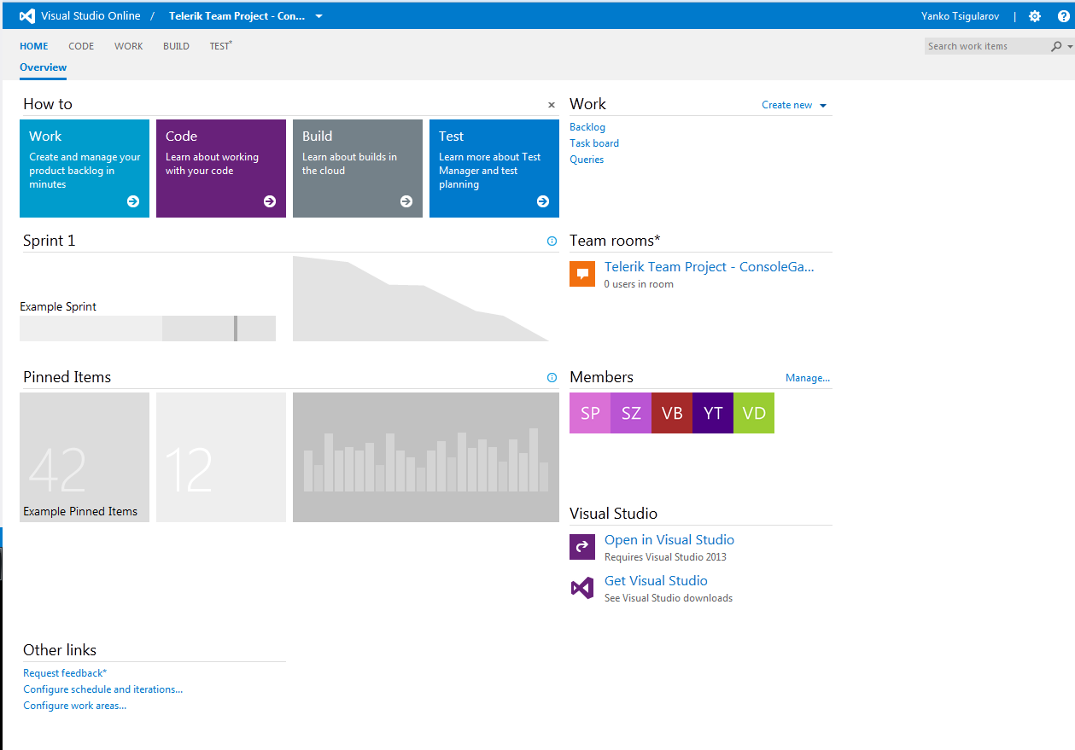
Team collaboration
* Used Source control system
http://tfs.visualstudio.com
https://tsigularoff.visualstudio.com/

Slide 5
Live Demo

Slide 6
Questions ?

